Slide 1



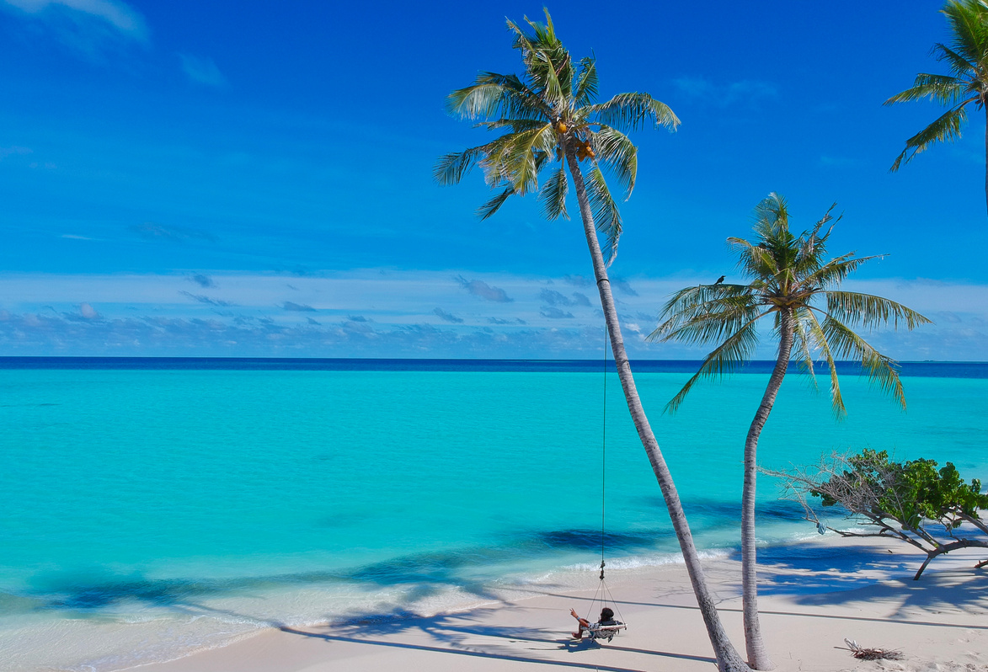











Web Scraping & Analysis on Home Stays/Resorts
trivago.com
"A RESORT IS NOT JUST A PLACE TO STAY — IT'S A PLACE TO ESCAPE, UNWIND, AND REMEMBER WHO YOU ARE."
+123-456-7890
123 Anywhere St., Any City
www.reallygreatsite.com

Slide 2







AGENDA
1
TRIVAGO seaching
engine
2
WebScraping and raw Data Extraction
3
Data Cleaning
4
Exploratory Data Analysis
What is Trivago.com.
What does Trivago do.
What Trivago offers.
Why users like Trivago.com
Data Collection Approach for Data Scraping
Raw Data extraction from web application
(“Trivago.com)
Handling Duplicate elements.
Managing missing data.
Handling Null data.
Data type Assignment.
Univariate Analysis Steps
Bivariate Analysis
Steps

Slide 3
Problem Statements on Finding Better Hotels While Travelling/Exploring
1.Overwhelming Choices: “Travelers struggle to choose the right hotel due to the overwhelming number of options available online, making it hard to identify which offers the best value.”
2.Hidden Costs & Lack of Transparency: “Despite attractive deals, hidden charges and unclear pricing structures prevent travelers from confidently selecting the best hotel.”
3.Mismatch Between Expectation & Reality: “Travelers often face disappointment as hotels may not match the descriptions or ratings shown online, leading to dissatisfaction.”
4.Balancing Cost and Comfort: “Finding a hotel that balances affordability, comfort, and location remains a key challenge for travelers.”
5.Time-Consuming Search: “Travelers waste significant time browsing multiple websites and apps before finalizing a hotel, reducing the convenience of planning a trip.”

Slide 4
TRIVAGO
trivago.com
"A RESORT IS NOT JUST A PLACE TO STAY — IT'S A PLACE TO ESCAPE, UNWIND, AND REMEMBER WHO YOU ARE."
+123-456-7890
123 Anywhere St., Any City
www.reallygreatsite.com

Slide 5
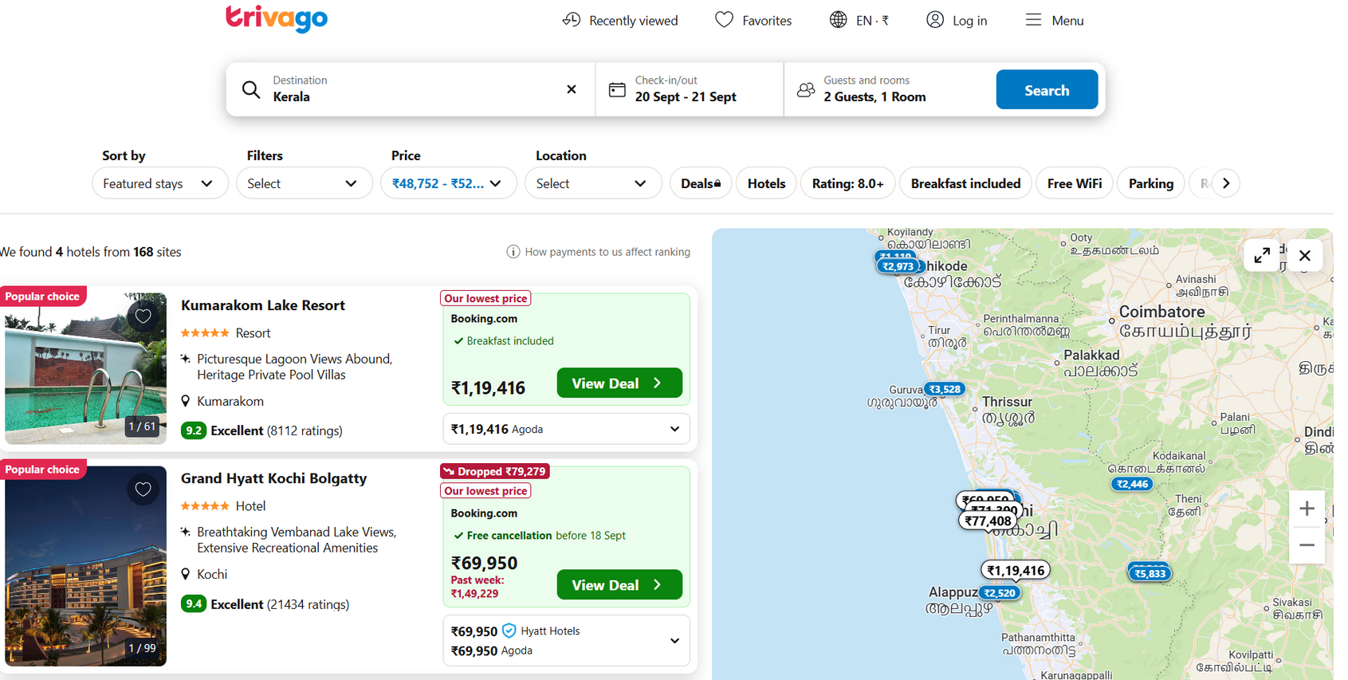
What is Trivago.com?
➡️Trivago is a hotel and accommodation search engine. It helps users compare hotel prices from various booking sites like Booking.com, Expedia, Agoda, Hotels.com, and more — all in one place.
🌍 Website: https://www.trivago.com

Slide 6
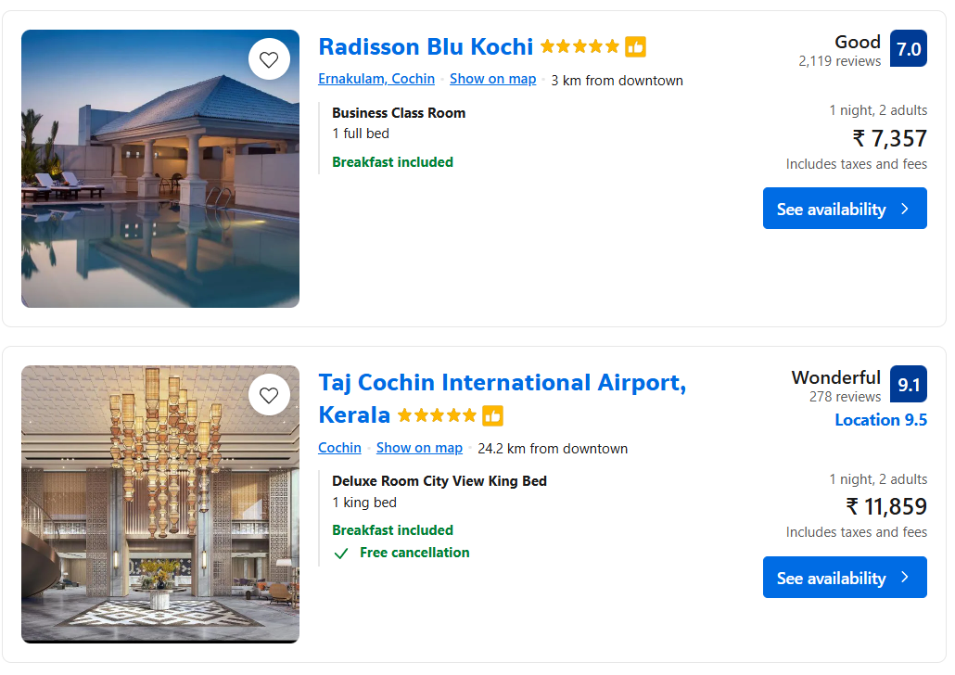
🛎️ What Trivago Offers:
➡️Hotel Price Comparison
Users enter a location and dates.
Trivago shows a list of available hotels with prices from different booking sites.
You can compare prices for the same room across platforms.
➡️Filters & Sorting
Sort hotels by price, rating, distance, popularity, etc.
Filter by stars, amenities (Wi-Fi, parking, pet-friendly), type (resort, hostel), etc.

Slide 7
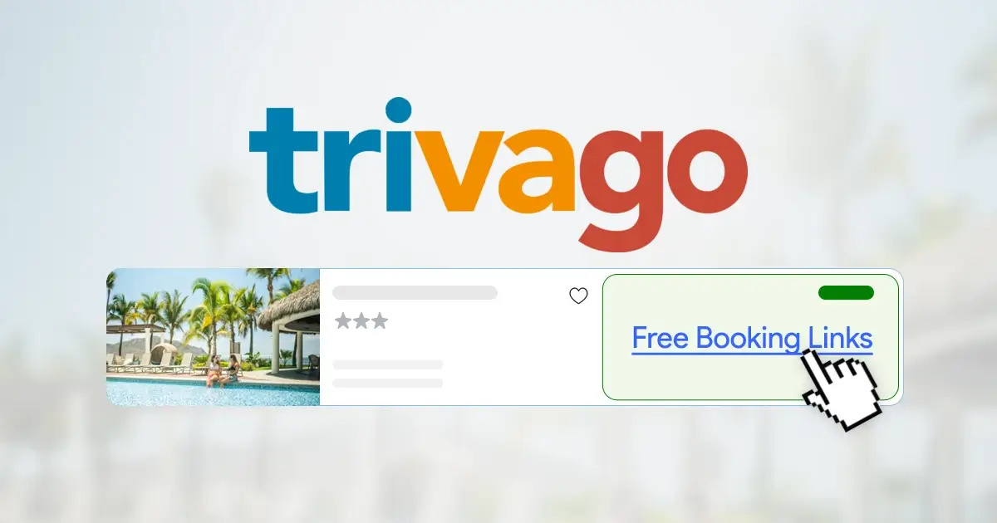
➡️Meta-Search Engine
Trivago doesn't sell rooms — it's a meta-search engine.
It earns money through cost-per-click advertising (hotels or booking sites pay when users click through).
💡 Why Users Like It
Saves time by comparing hundreds of sites quickly.
Easy to use.
Sometimes helps find better deals.

Slide 8
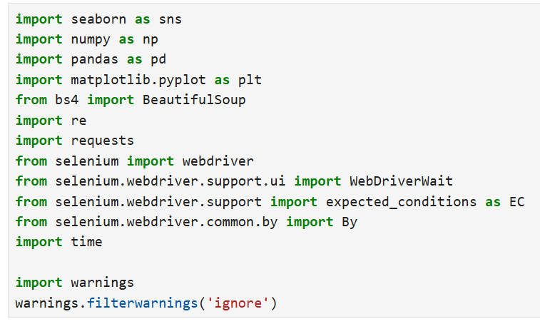

WebScraping(Trivago.com)
Step 1: Importing Libraries
Data analysis and visualization libraries (like Pandas, NumPy, Matplotlib, Seaborn).
Web scraping tools (BeautifulSoup, Requests, Selenium).
Utility modules (Regular expressions, Time, Warnings).
Step 2: Website URL
The URL contains details such as location, date range, and price range.This defines exactly what hotel listings we want to fetch.

Slide 9
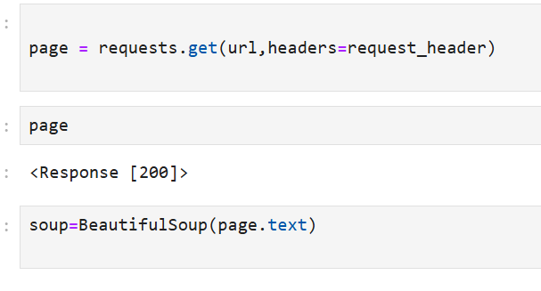
Step 3: Adding Request Headers
To avoid this, we add a User-Agent header which makes our request look like it is coming from a normal browser.
This helps bypass basic security checks and ensures the page loads properly
Step 4: Sending the Request
If the request is valid, the server sends back the HTML content of the hotel search pag
Step 5: Checking the Response
200 = Success (the page loaded correctly).
Other codes like 403 (Forbidden) or 404 (Not Found) indicate errors.

Slide 10
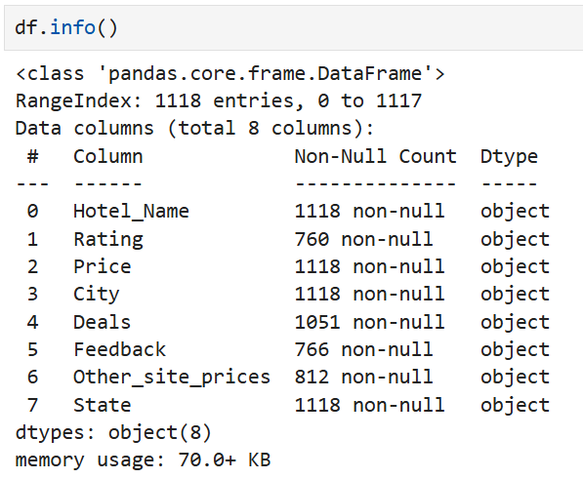
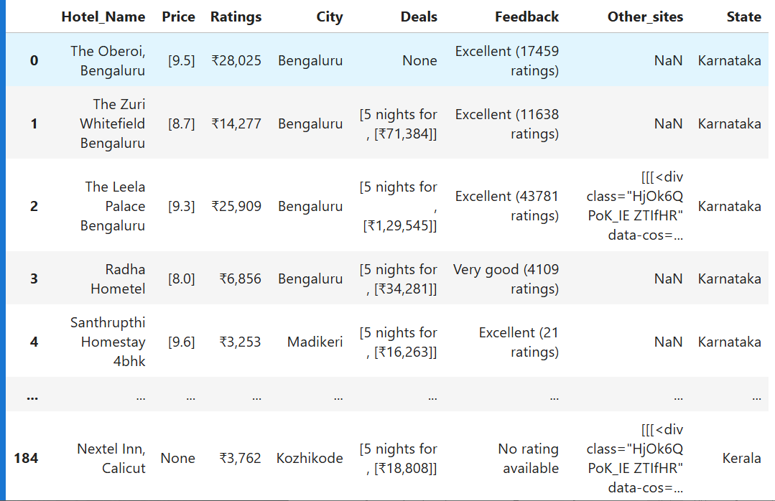
SUMMARY OF RAW DATA
1.RAW Data Overview
2. Data Volume
The raw datasets which includes resort name,price,
offers,ratings,,other site deals and feedbacks, etc,
in south states of India.
Hotel_Name,Price,Ratings ,City ,Deals ,Feedback,Other_sites ,State
Dataset shape: 1118 rows × 8 columns

Slide 11
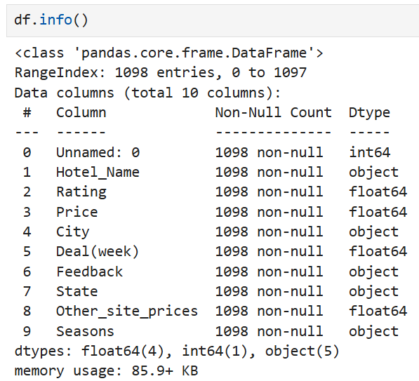

INTRO to DATASET
Raw Data
Cleaned Data

Slide 12

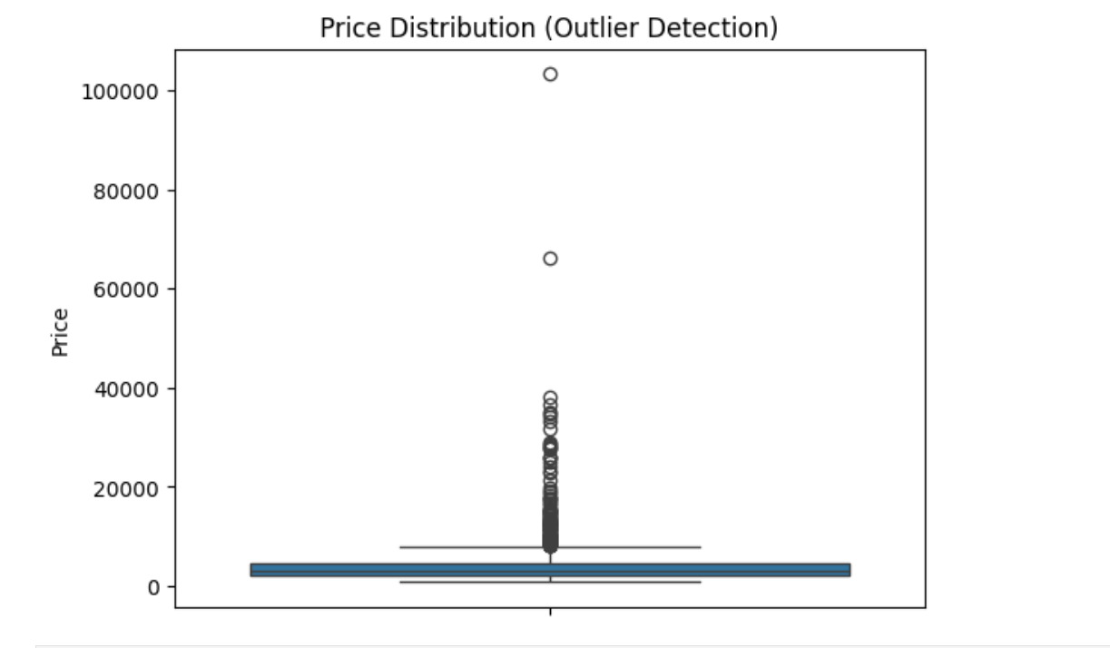
Exploratory Data Analysis
1.Univariate Analysis Steps
📊Price Distribution (Boxplot)
Purpose → The boxplot shows the distribution of hotel prices and helps us detect outliers.
Main Observation →
Most hotels fall within a lower price range (near the bottom of the graph).
Several hotels have extremely high prices, shown as points far above the main cluster.
Outliers →
These are unusually high-priced hotels compared to the majority.
Outliers can heavily influence average price calculations.
Insight →
The market has a wide variation in pricing, with a small number of luxury hotels charging much higher than typical ranges.

Slide 13
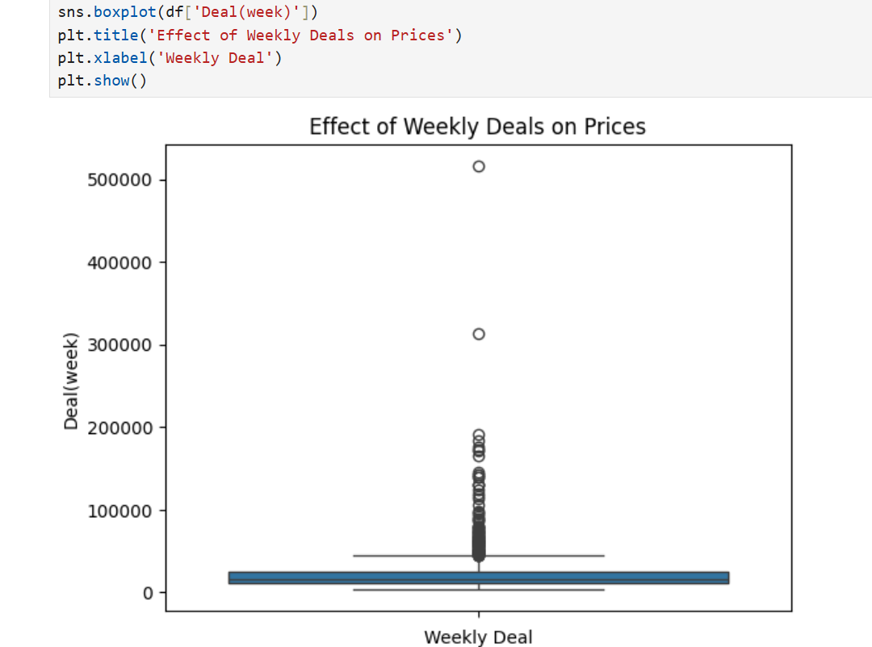
📊 Effect of Weekly Deals on Prices (Boxplot Explanation)
This boxplot is used to analyze how weekly deals impact hotel prices.
It also helps in identifying outliers (unusually high or low deal prices).
Insight -->
Outliers highlight premium or luxury hotels
with high weekly rates.
Majority clustering at the lower range
suggest affordability for most travelers.
This can help in customer segmentation :
1.Budget travelers → take advantage
of lower weekly deals.
2.Premium travelers → targeted toward
high-value outlier deals.

Slide 14
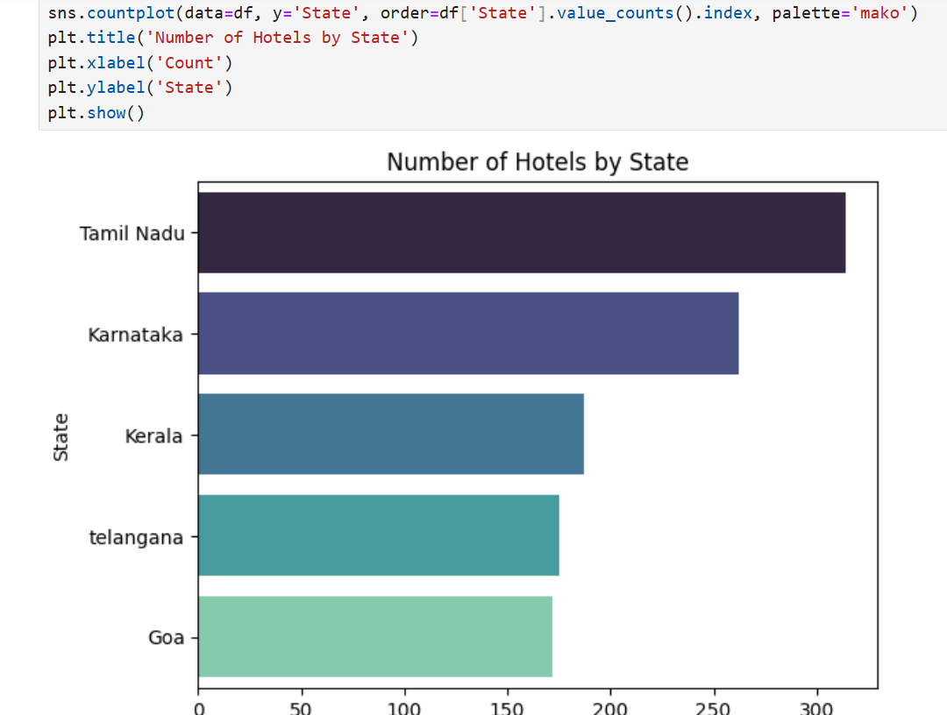
📊 Number of Hotels by State
Purpose → This chart shows the distribution of hotels across different states in the dataset.
Main Observations →
.
Tamil Nadu has the highest number of hotels listed.
Karnataka comes next with slightly fewer hotels.
Kerala, Telangana, and Goa have fewer hotels compared to
Tamil Nadu and Karnataka.
Insight →
The hotel listings are not evenly distributed.
Southern states like Tamil Nadu and Karnataka dominate the dataset, indicating more tourism or hotel availability there.
States like Goa and Telangana have fewer listings, possibly due to limited coverage or smaller dataset representation.

Slide 15
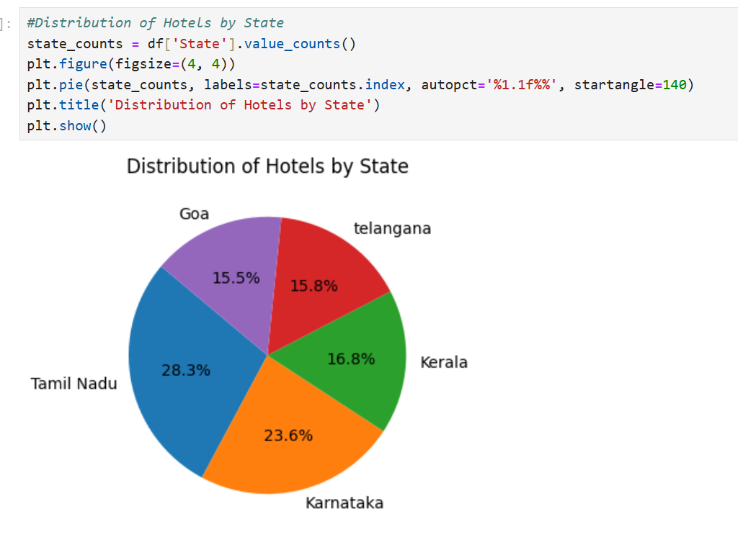
📊Distribution of Hotels by State
Insights:
Southern states dominate the hotel distribution, especially Tamil Nadu and Karnataka.
This may reflect higher tourism, urban development, or business hubs in these regions.
Understanding this distribution helps in:
-->Targeting tourism campaigns
-->Planning hotel expansions
-->Analyzing market saturation

Slide 16
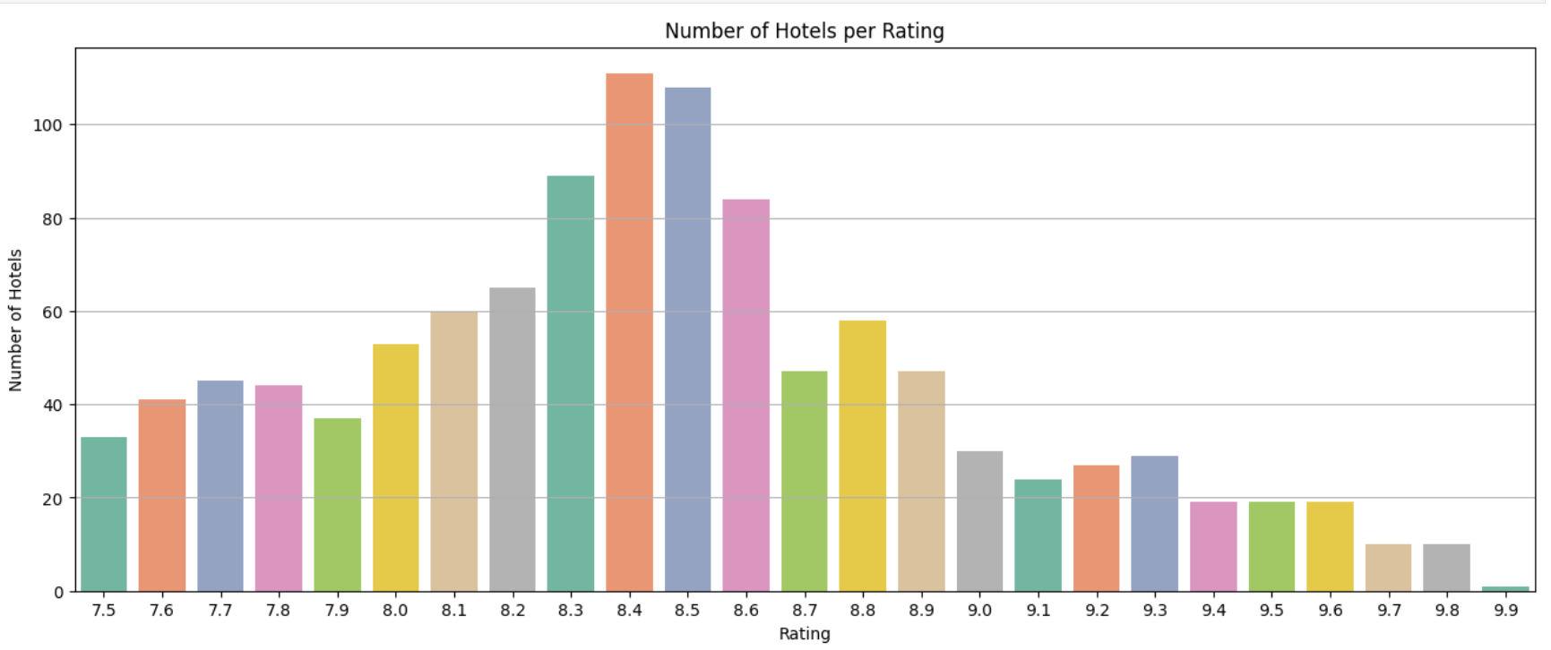
📊 Number of Hotels per Rating
-->Mid-to-high-rated hotels (8.0–8.6) dominate the dataset.
-->Extremely high ratings (above 9.5) are rare,
suggesting:High standards to achieve top scores.
Insights:
Possibly stricter guest expectations or fewer reviews.
-->Ratings below 8.0 indicate a smaller but significant portion of hotels may need
service or quality improvements.

Slide 17
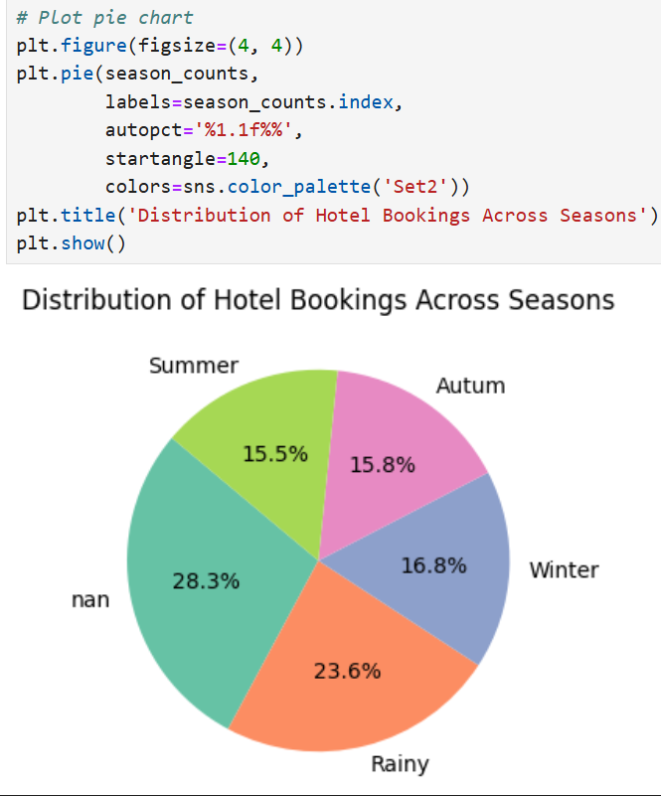
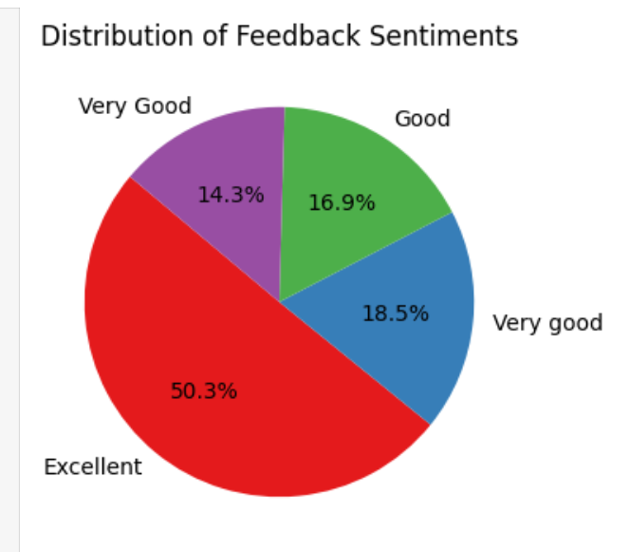
📊Distribution of Hotel Bookings Across Seasons & FeedBack

Slide 18
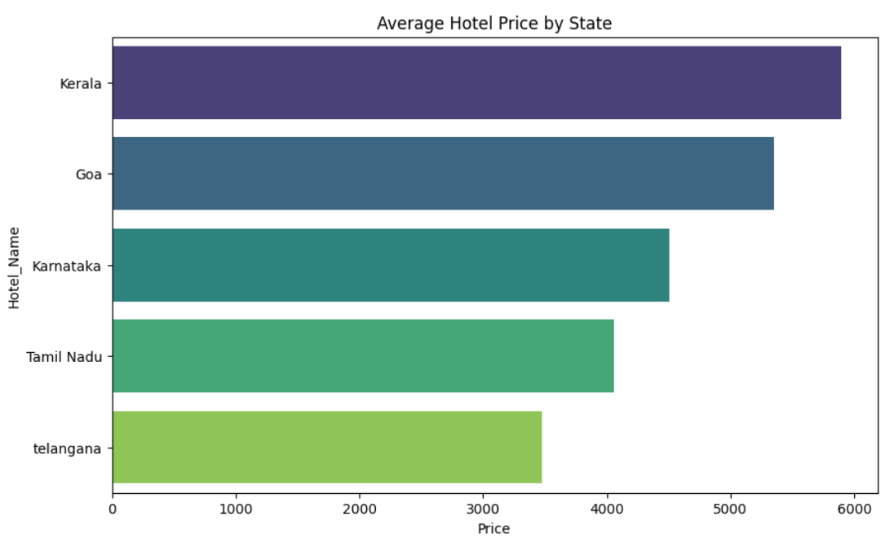
2.Bivaiate Analysis
📊Average Hotel Price by State
This horizontal bar chart visualizes the average hotel prices across five states in India. The states
are listed on the Y-axis while the X-axis represents the average price values (in INR).

Slide 19
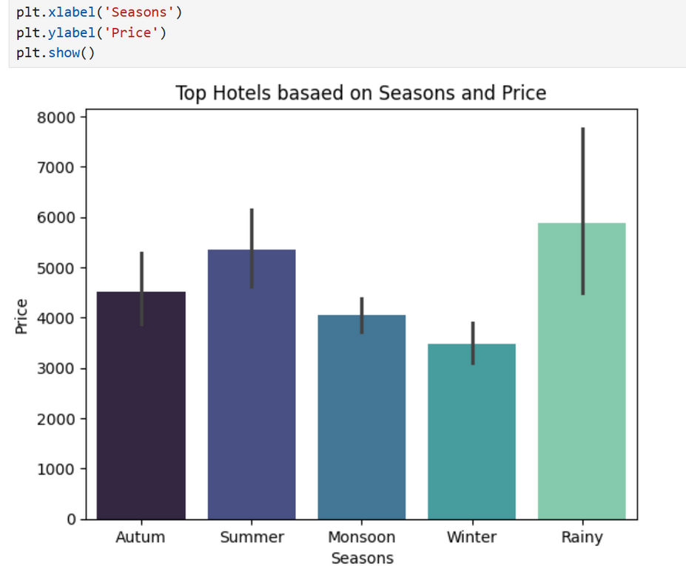
📊
Top Hotels based on Seasons and Price
X-axis (Seasons): Shows different seasons – Autumn, Summer, Monsoon, Winter, and Rainy.
Y-axis (Price): Represents the average price of hotels during each season.
Bars: Indicate the price level for each season, while the black vertical lines represent the variation
Insights:
Rainy Season has the highest hotel prices (~₹5900), with a wide variation, showing hotels can get quite expensive.
Summer is the second most expensive (~₹5300), likely due to higher travel demand.
Autumn sits in the mid-range (~₹4500).
Monsoon (~₹4000) and Winter (~₹3500) are the cheapest seasons for hotels.
Variation (error bars) shows more price fluctuations in Rainy and Summer, while Monsoon and Winter have relatively stable pricing.

Slide 20
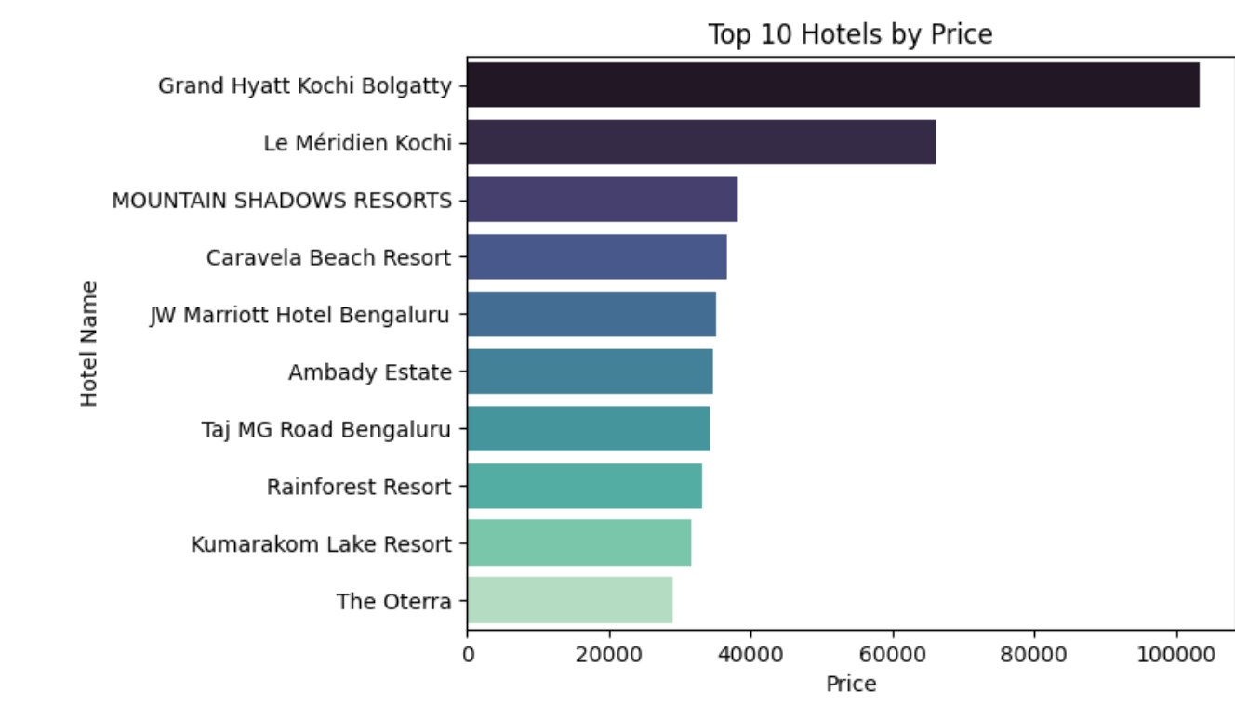
📊Top 10 Hotels by Price
X-axis (Price): Shows hotel prices.
Y-axis (Hotel Name): Lists the top 10 hotels ranked by their
pricing.
Bars: Represent the hotel price levels, where longer bars indicate
higher prices.
Insights:
Grand Hyatt Kochi Bolgatty is the most expensive hotel, with prices exceeding ₹1,00,000.
Le Méridien Kochi follows as the second most expensive, priced above ₹60,000.
Hotels like MOUNTAIN SHADOWS RESORTS, Caravela Beach Resort, and JW Marriott Bengaluru fall in the mid-price range (~₹35,000–₹40,000).
The relatively lower-priced hotels among the top 10 include The Oterra and Kumarakom Lake Resort, priced around ₹30,000–₹32,000.

Slide 21
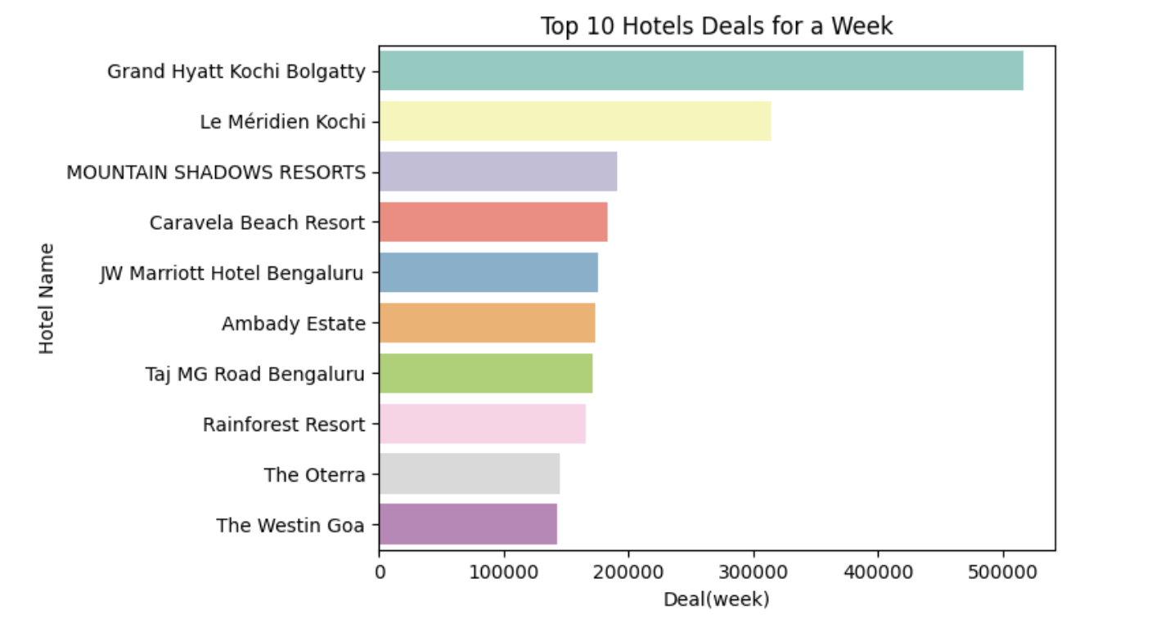
📊Top 10 Hotels Deals for a Week
X-axis (Deal/week): Shows the cost of staying for one week.
Y-axis (Hotel Name): Lists the hotels with the highest weekly deals.
Bars: Represent the deal values; longer bars indicate higher weekly prices.
Insights:
Grand Hyatt Kochi Bolgatty offers the most expensive weekly deal, crossing ₹5,00,000.
Le Méridien Kochi comes second, with deals above ₹3,00,000.
Hotels like MOUNTAIN SHADOWS RESORTS, Caravela Beach Resort, and JW Marriott Bengaluru fall into the mid-range (~₹1,80,000–₹2,00,000 per week).
The most affordable weekly packages among the top 10 are The Oterra and The Westin Goa, priced around ₹1,40,000–₹1,50,000.

Slide 22
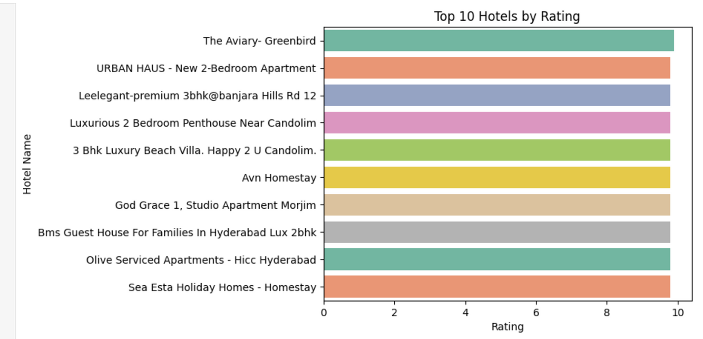
📊 Top 10 Hotels by Rating
X-axis (Rating): Represents the hotel rating score (out of 10).
Y-axis (Hotel Name): Lists the hotel/apartment names ranked by rating.
Bars: Each bar shows the rating value of the hotel.
Insights:
All top 10 hotels have exceptionally high ratings, almost reaching the maximum score of 10/10.
Properties include a mix of luxury apartments, villas, serviced apartments, and homestays, suggesting that both premium and homestay categories deliver strong customer satisfaction.
Hotels such as The Aviary – Greenbird, URBAN HAUS, and Leeleegant Premium Apartments stand out among the highest-rated.
Consistent ratings across all hotels show that customers are generally very satisfied, with no significant gaps in quality among the top-rated hotels.

Slide 23
📊Top 10 Hotels Deals for a Week
X-axis (Deal/week): Shows the cost of staying for one week.
Y-axis (Hotel Name): Lists the hotels with the highest weekly deals.
Bars: Represent the deal values; longer bars indicate higher weekly prices.
Insights:
All top 10 hotels have exceptionally high ratings, almost reaching the maximum score of 10/10.
Properties include a mix of luxury apartments, villas, serviced apartments, and homestays, suggesting that both premium and homestay categories deliver strong customer satisfaction.
Consistent ratings across all hotels show that customers are generally very satisfied, with no significant gaps in quality among the top-rated hotels.

Slide 24




THANK YOU

